Slide 1

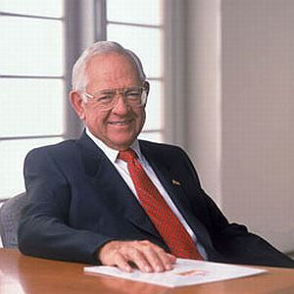


Ba 260 Lecture 1
What is Entrepreneurship?
Academic Definition (Stevenson & Jarillo)
Entrepreneurship is the process by which individuals pursue opportunities without regard to resources they currently control.
Venture Capitalist (Fred Wilson)
Entrepreneurship is the art of turning an idea into a business.
Explanation of What Entrepreneurs Do
Entrepreneurs assemble and then integrate all the resources needed – the money, the people, the business model, the strategy – to transform an invention or an idea into a viable business.

Slide 2
Ba 260 Lecture 1
The three primary reasons that people become entrepreneurs and start their own firms
Desire to be their own boss
Desire to pursue their own ideas
Financial rewards
Questions
Do you agree or disagree with these
What are the negatives to all three of these

Slide 3
Ba 260
Four Characteristic's of an Entrepreneur
Passion for the Business
Product/Customer Focus
Tenacity Despite Failure
Execution Intelligence

Slide 4
Ba 260
Myths about Entrepreneurs
Myth 1: Entrepreneurs Are Born, Not Made
Myth 2: Entrepreneurs Are Gamblers
Myth 3: Entrepreneurs Are Motivated Primarily by Money
Myth 4: Entrepreneurs Should Be Young and Energetic
Notes:
The maned wolf (Chrysocyon brachyurus) is the largest canid of South America. Its markings resemble those of foxes, but it is not a fox, nor is it a wolf, as it is not closely related to other canids. It is the only species in the genus Chrysocyon (meaning "golden dog").
This mammal is found in open and semi-open habitats, especially grasslands with scattered bushes and trees, in south, central-west, and southeastern Brazil (Mato Grosso, Mato Grosso do Sul, Minas Gerais, Goiás, São Paulo, Federal District, and recently, Rio Grande do Sul), Paraguay, northern Argentina, Bolivia east and north of the Andes,[4] and far southeastern Peru (Pampas del Heath only).[5] It is very rare in Uruguay, possibly being displaced completely through loss of habitat. IUCN lists it as near threatened, while it is considered vulnerable by the Brazilian government (IBAMA).

Slide 5

Ba 260
Types of Firms
What are some examples of these

Slide 6

Ba 260
The Entrepreneurial Process consists of four steps
Step 1: Deciding to become an entrepreneur.
Step 2: Developing successful business ideas.
Step 3: Moving from an idea to an entrepreneurial firm.
Step 4: Managing and growing the entrepreneurial firm.
Original Starbucks

